Slide 1


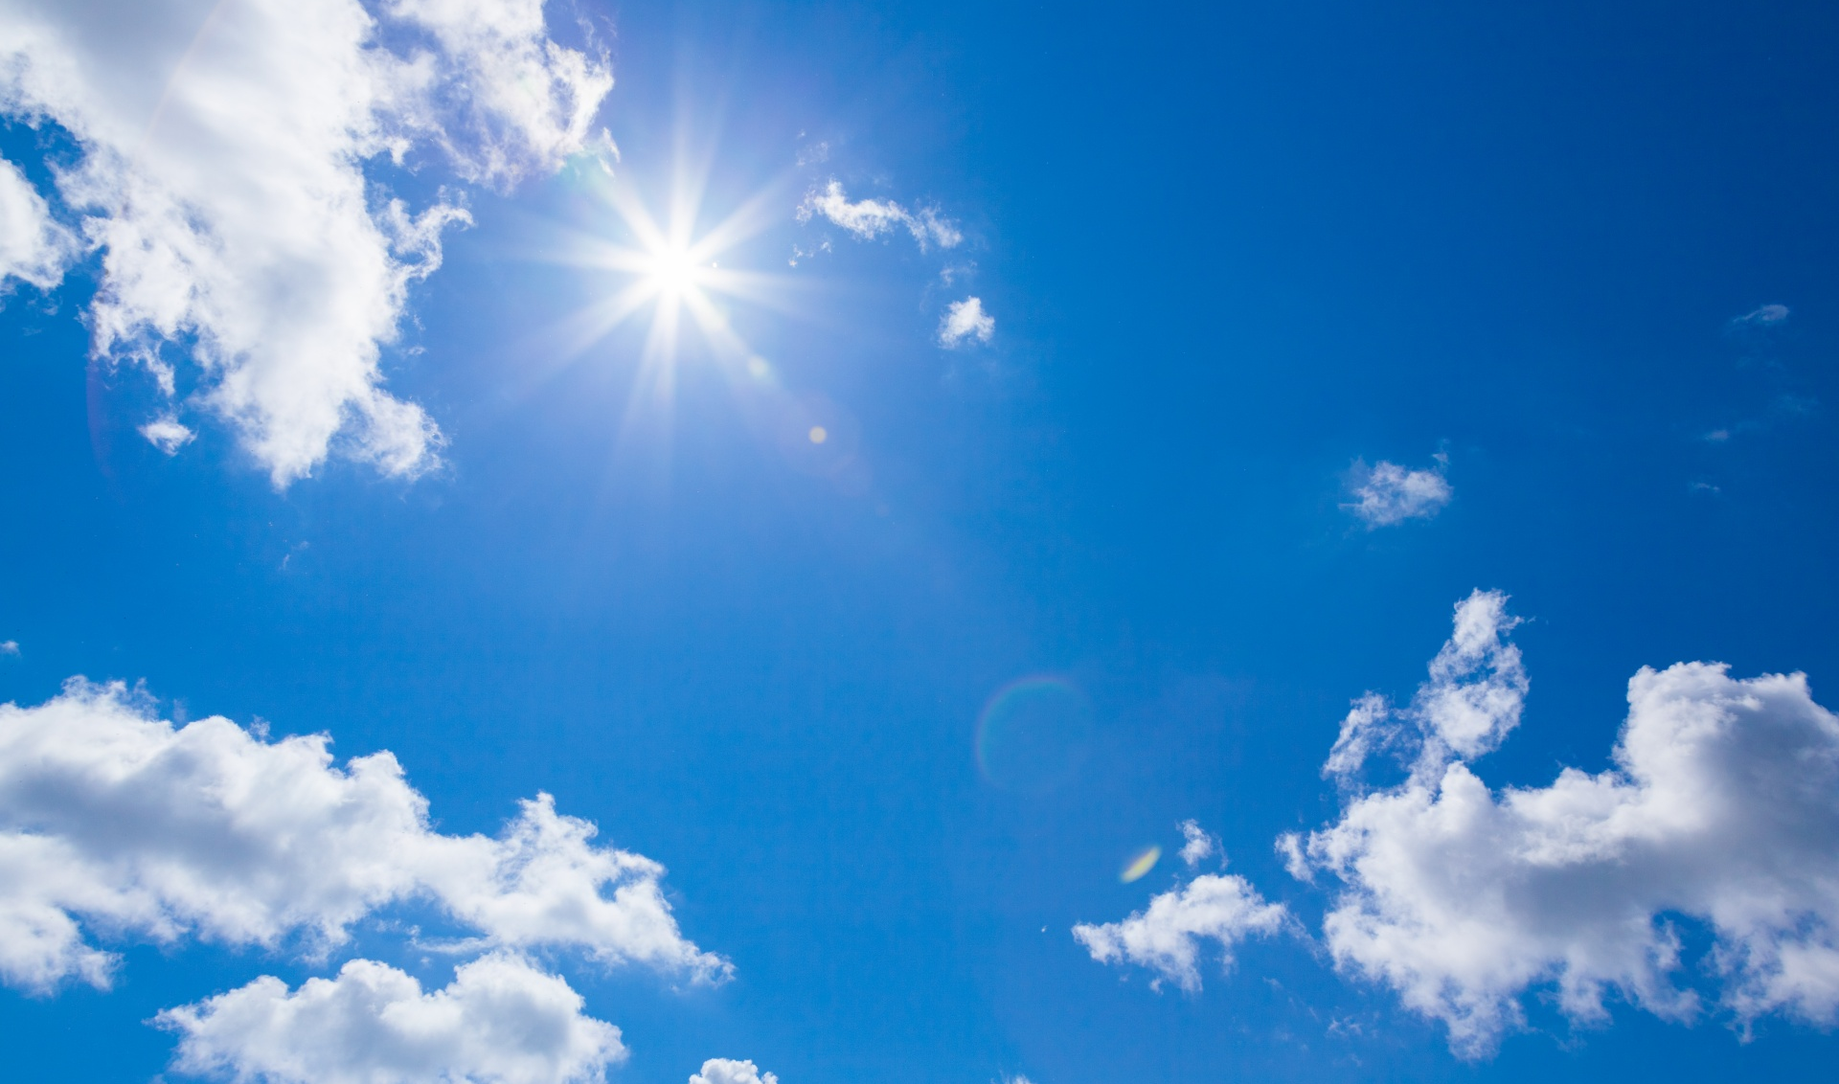
WEATHER APP
By Code Crafters

Slide 2


responsibilities
PARTH AZAD: FETCHING DATA FROM API AND CONVERTING INTO PYTHON LANGUAGE
DIVYANSH JAIN:STORING FETCHED DATA IN THE IDENTIFIERS
DHRUV: FRONTEND AND GUI MANAGEMENT

Slide 3

INTRODUCTION
Welcome to the presentation on Weather App. In this presentation, we will make a Python-based weather application that aims to inform us of the current weather conditions in cities. This app will help us to know the Weather , sunlight , cloud ,and many more……

Slide 4

User friendly interface
The user interface of our weather app is designed to be intuitive and visually appealing. Users can easily access current
weather information, sunrise sunset, humidity. With its simple navigation and user-friendly features, our app caters to users of all backgrounds and weather information needs.

Slide 5
Application and benefits
The Python-based weather app offers numerous beneﬁts and applications. It empowers individuals to plan their activities based on weather conditions, helps businesses optimize operations. Additionally, researchers and meteorologists can utilize the app's data and insights for further analysis and studies.

Slide 6
ALGORITHM
There are various process by which we can make our code:
1 Title of our Window
2 Functions to fetch and display weather info
3 Storing the fetched value of weather in a city
4 Assigning values to our weather variable, to display an output
5 Frontend part of the code- Interface

Slide 7

Thank you ~CODE CRAFTERS

